Slide 1



AI-Driven Scholarship Eligibility and Application Recommendation Portal
By:
VANGIMALLA BALA SIVA PRASAD REDDY
(192424316)
MOHAMED IMRAAN S (192424001)
ALLEN GABRIEL M (192421089)
Guided By:
Dr Sivasanker C

Slide 2
Problem Background
Many scholarship portals provide only basic search and application services.
Students find it difficult to identify scholarships that match their profile.
Existing systems often provide limited or non-personalized recommendations.
Students still spend time checking eligibility for multiple scholarships.
An AI-driven portal can provide accurate eligibility prediction and personalized scholarship recommendations.

Slide 3
Problem Statement
Existing scholarship portals do not always provide personalized recommendations.
Eligibility checking across different scholarships can be time-consuming.
Students may miss suitable scholarships due to complex eligibility criteria.
Managing applications through different portals is inconvenient.
An AI-driven recommendation portal can simplify scholarship discovery and improve application success.

Slide 4
Objectives
To create a student profile that stores academic and personal details.
To predict scholarship eligibility based on the student's profile.
To recommend suitable scholarships using AI-based analysis.
To simplify the scholarship application process through a single platform.
To help more students apply for scholarships and reduce missed opportunities.

Slide 5
Literature Review
S.No | Title of the paper | Publisher and Published Year | Components /Techniques used
1 | AI-Based Scholarship Recommendation System | IEEE, 2025 | Machine Learning, Student Profile Analysis, Recommendation System
2 | Intelligent Student Scholarship Management System | Springer, 2025 | Eligibility Prediction, Web Application, Database Management
3 | Machine Learning for Educational Decision Support | ScienceDirect, 2024 | Classification Algorithms, Student Data Analysis, Prediction Models
4 | Smart Scholarship Portal Using Artificial Intelligence | IEEE, 2024 | AI Recommendation Engine, User Authentication, Dashboard
5 | Online Scholarship Management System | Elsevier, 2025 | Application Tracking, Notification System, Database Integration

Slide 6
Existing vs Proposed System
Existing System | Proposed System
Provides a list of scholarships. | Recommends scholarships based on the student's profile.
Eligibility checking is limited or manual for many schemes. | AI predicts eligibility automatically.
Recommendations are not fully personalized. | Personalized recommendations using AI.
Application tracking is limited. | Complete application tracking with status updates.
Limited notification support. | Timely notifications and reminders.
Basic search features. | Smart filtering and AI-based recommendations.

Slide 7
Requirements
Hardware Requirements
Laptop/Desktop
Intel i3 Processor or above
4 GB RAM or above
10 GB Free Storage
Internet Connection
Dataset / APIs
Student Academic Dataset
Scholarship Eligibility Dataset
Government Scholarship Portal Data
Software Requirements
Windows 10/11
IntelliJ IDEA
React.js
Node.js
MongoDB

Slide 8
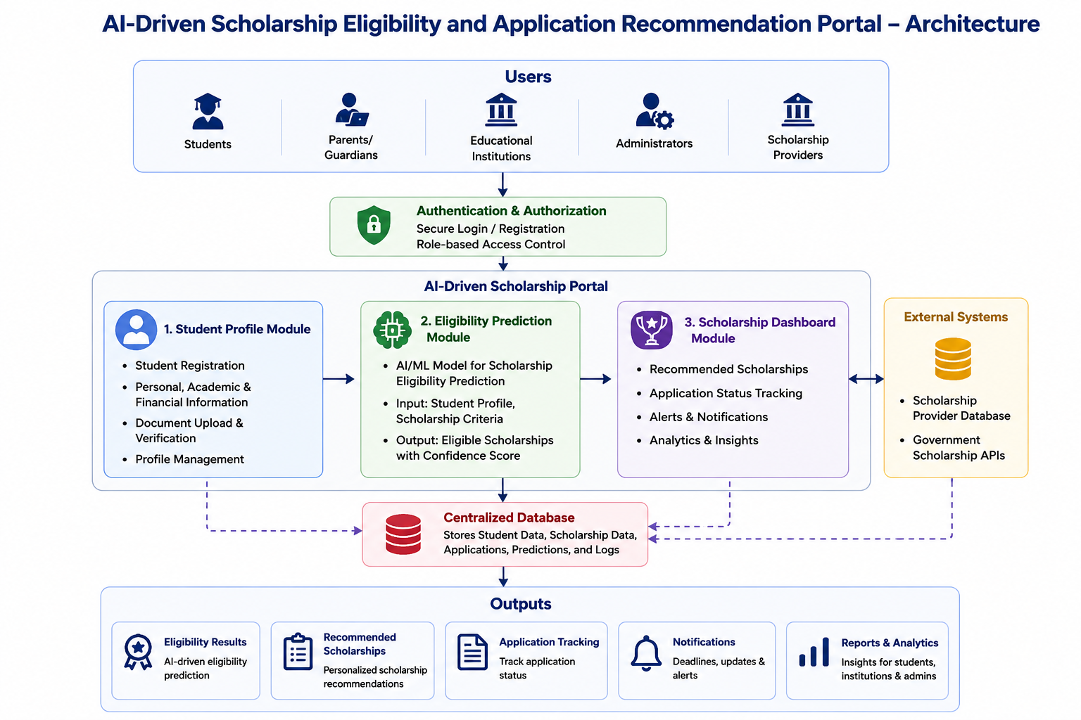
Architecture

Slide 9
Planning
Risk Analysis
Risk | Mitigation
Incomplete student data | Validate input before processing
Incorrect AI recommendations | Train and test the model with quality data
Server or database failure | Perform regular backups and monitoring
Delay in project development | Follow the planned project schedule
Work Breakdown Structure (WBS)
Requirement Analysis
System Design
AI Model Development
Frontend Development
Backend & Database Integration
Testing and Deployment

Slide 10
References
[1] Ministry of Education, Government of India, National Scholarship Portal (NSP). Available: https://scholarships.gov.in/
[2] AICTE, Pragati, Saksham and AICTE Scholarship Schemes. Available: https://www.aicte-india.org/
[3] Buddy4Study, Scholarship Search and Application Portal. Available: https://www.buddy4study.com/
[4] Vidya Lakshmi Portal, Education Loan and Scholarship Portal. Available: https://www.vidyalakshmi.co.in/
[5] IEEE Xplore Digital Library, Artificial Intelligence in Education: A Review of Machine Learning Applications, IEEE. Available: https://ieeexplore.ieee.org/
[6] Elsevier ScienceDirect, Machine Learning Applications in Higher Education and Student Decision Support, Available: https://www.sciencedirect.com/
[7] SpringerLink, Artificial Intelligence for Educational Decision Support Systems, Available: https://link.springer.com/
[8] Kaggle, Student Performance Dataset. Available: https://www.kaggle.com/
[9] UCI Machine Learning Repository, Student Performance Data Set. Available: https://archive.ics.uci.edu/
[10] Google AI, Machine Learning Crash Course. Available: https://developers.google.com/machine-learning/crash-course

